Slide 1
Intro to Adobe Illustrator
COMP1008 - Adobe Illustrator

Slide 2

What exactly is Adobe Illustrator?
Adobe Illustrator (AI) is vector graphics design tool. It’s used to create vector graphics such as icons, logos, cartoons, fonts, layouts (business cards), etc…
PS and AI share a lot of the same tools, however some are different. Which we will be learning about shortly. Just keep mind that you shouldn’t be editing photos (jpgs) in AI, that’s for Photoshop! Plus it’s hard to edit photos in AI when it doesn’t have the right tools for the job!

Slide 3
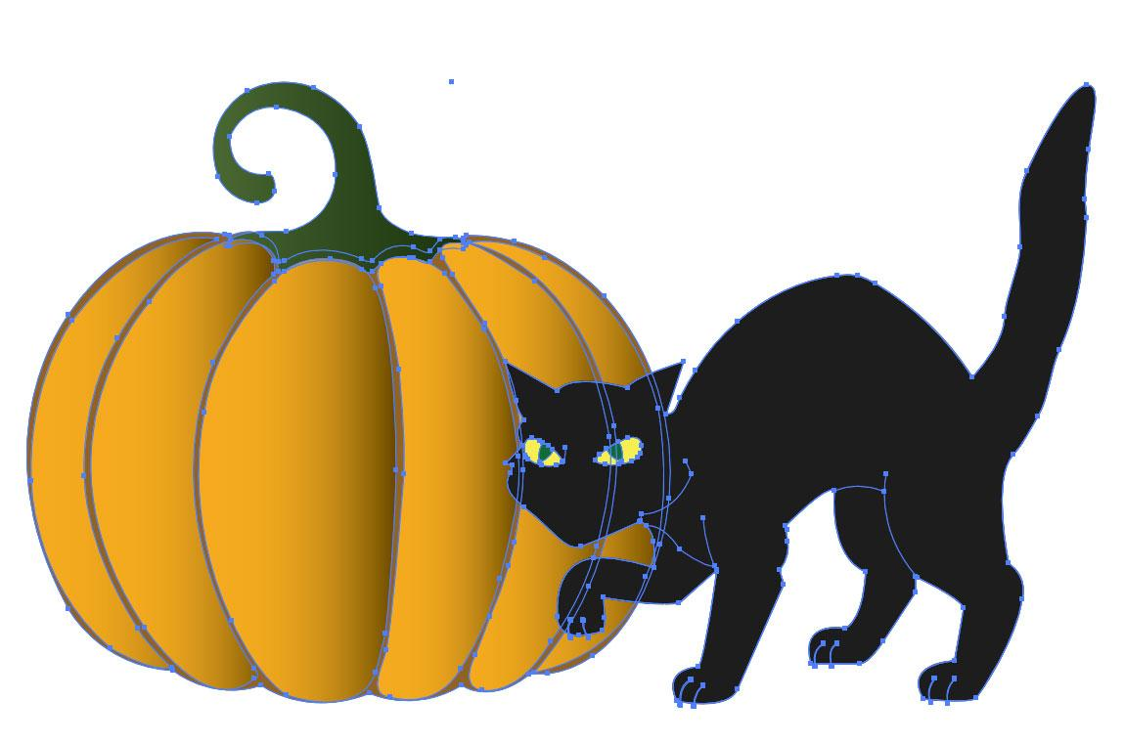
Vector Images/illustrations
Vector images are mathematically based using algorithms to create vector graphics, which can be scaled up or down with losing any image quality.

Slide 4
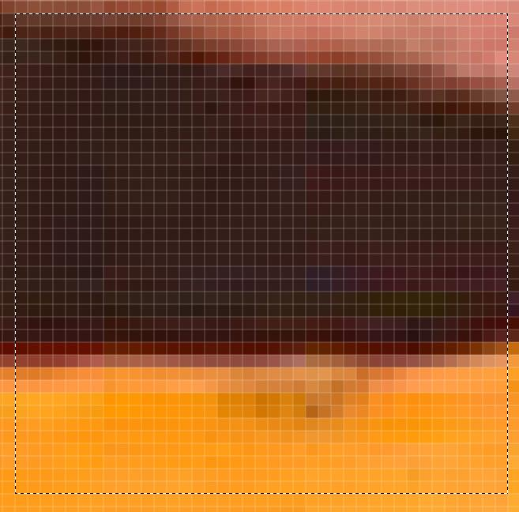
Raster Images
Raster or bitmap images are pixel dependant and don’t always scale as nicely as we’d like.
Raster images when sized to a certain image should be scaled to higher - as you risk losing image quality, but you can scale your images down.

Slide 5
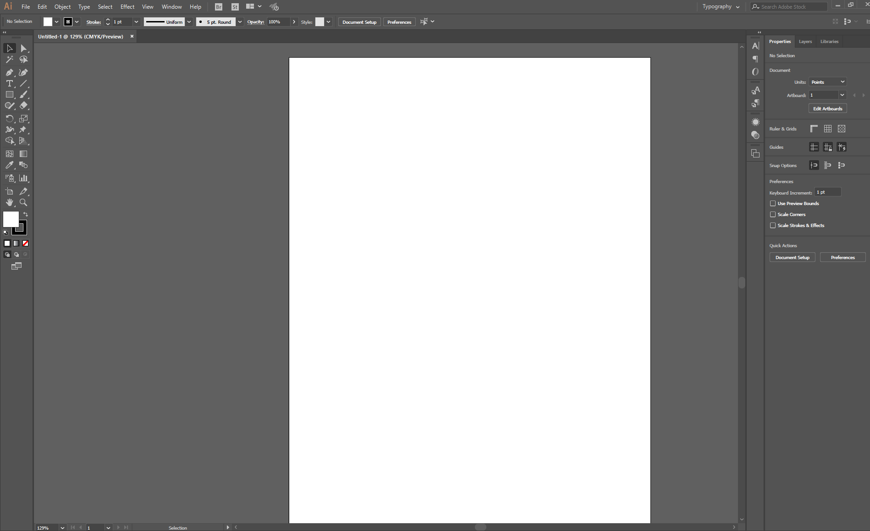
Root menu and control Panel
Layers and other palettes
Tool palette
Artboard

Slide 6
Basic Shapes
In Illustrator we can create a lot of different basic shapes, some of those are:
Line
Rectangle or rounded rectangle
Ellipse
Polygon
Star
Flare Tool
Brush and or Blob Brush
Pen Tool
Let’s test out some of these shapes! Open up Illustrator!

Slide 7

Shape components & Manipulation
Using AI we can take our shapes and manipulate them anyway we want. We have a number of tools in illustrator to help us accomplish this.
For example, let’s make a couple of shapes and give them some colour.
Stroke
Now let’s take these shapes and manipulate them!
Fill

Slide 8
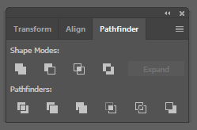
Shape components & Manipulation
Using the pathfinder tool (window > pathfinder) we are going to learn how to manipulate shapes.
This tool comes is really hand when creating shapes and objects.

Slide 9





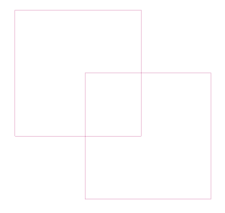



Shape components & Manipulation
No manipulation
Unite
Minus Front
Exclude
Divide
Trim
Merge
Crop
Outline
Minus Back

Slide 10
Shape components & Manipulation
Unite
Minus Front
Intersect
Exclude

Slide 11
Shape components & Manipulation
Intersect
Merge
Crop
Outline
Minus Back
Trim

Slide 12
Shape builder tool
Another tool we can use when building and manipulating or shapes is the shape builder tool. Which can be found in our tools palette.
To use this tool, select all of your objects using your selection tool (v)
Click on your shape builder tool ( shift + M). When you hover your cursor over the desired shaped you will see that the area turns to mesh. Click to select an area or drag to select multiple areas.

Slide 13
Keyboard Shortcuts
alt / opt key - allows you duplicate an item when it is selected.
a - switches to your direct selection arrow/tool (white arrrow) - allows you to select single nodes.
v - selects the selection arrow (black arrow)
space-bar: hold down spacebar to move your screen and or artboard around.
p - selects the pen tool
When p is selected you hit plus(+) and you’ll be able to add more anchor points
Minus (-) you can eliminate/remove nodes.
shift + o: allows you edit or add/remove your artbords
t - create text
shift + ctrl + o / shift + cmd + o : creates outlines (e.g. turns fonts into vectors)

Slide 14
More Keyboard Shortcuts
[ and ]- Often decreases or increases the size of the tool (If these don’t work then the tool may use up and down arrows)
Ctrl + C - Copy
Ctrl + V - Paste centered
Ctrl + F - Paste directly in front of copied object
Alt when using Pencil - After starting to draw with the pencil and pressing Alt, system will close the shape with a straight line
Ctrl + [ - Send object back one level
Ctrl + ] - Bring object forward one level
Shift + Ctrl + [ or ] - Send back to lowest level or Bring forward to top level

